Slide 1
Senior Capstone
Software Issue & Change Management
Requirements Document
Donald Akujobi
Raymond Lemon
Amber Dawkins
Matthew King
Wayne State University

Slide 2
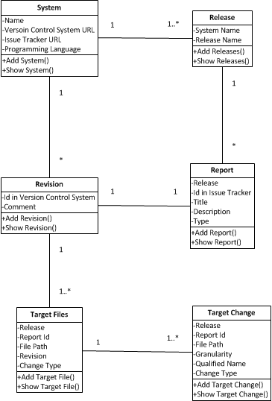
Class Diagram

Slide 3
Where we are at
Edited our previous page flow model to give a clearer view of how the website should work
Began researching how to setup MySQL Database and integrate it with our application
Began researching Hibernate for Object Relational Mapping between our application and our relational database

Slide 4
Things to do
Next Iteration 10/27-11/03:
Implement the remaining models and views: Changes, Target Change
Create the MySQL Database with the table relationships defined in our revised domain model. Begin Persisting data between our application and our database tables.
Begin Implementing pagination of information retreived in the “Show” links

Slide 5
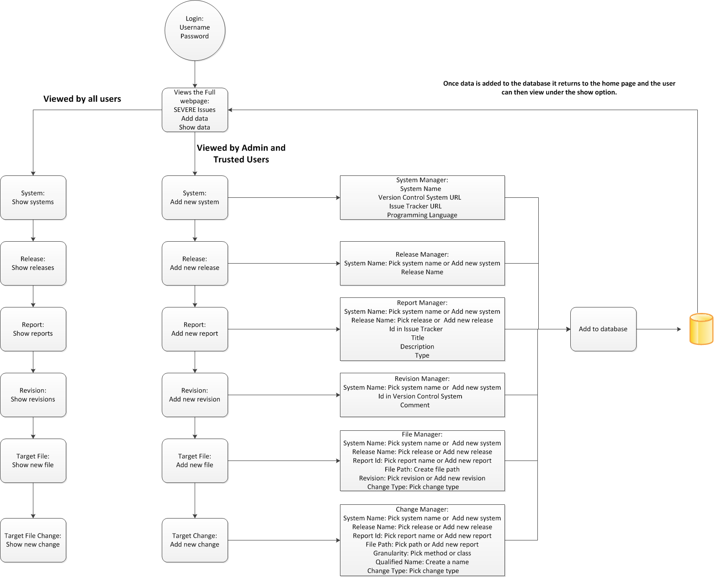
Data Flow Diagram

Slide 6
Resources:
Bootstrap
http://getbootstrap.com/
DesignDocuments/JavaTutorials:
http://www.youtube.com/user/derekbanas/videos?view=1&flow=grid
Spring, Hibernate, Spring MVC:
http://www.youtube.com/user/koushks/videos?view=1&flow=grid
HTML,CSS3,JavaScript:
http://thenewboston.org/tutorials.php

